Slide 1
Predicting Loan defaults using logistic regression
Sonja Tilly
November 17

Slide 2
Approach and method
Project
Dataset
Data exploration
Feature engineering
Classification
Building basic logistic regression model
Optimising model parameters
Results
Conclusion
Appendix

Slide 3
Project
Predict customers’ creditworthiness
(i.e. whether they will complete or default on a loan)
Build and test a logistic regression model
Use 70% of the data to build the model and then test the model using the remaining 30%
Notes:
The data contains rows of customers, with each column showing the features for loan applications that have been approved, together with outcomes of the loans (in the final column). The outcomes show that each customer has either defaulted or completed their loan.

Slide 4
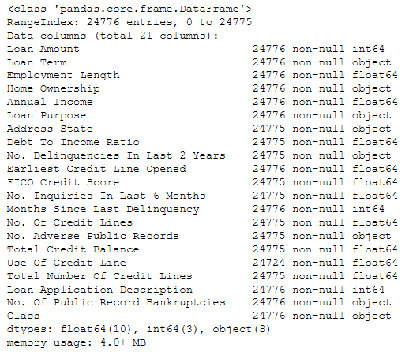
Lending Club dataset
The data contains rows of customers, with each column showing the features for loan applications that have been approved, together with outcomes of the loans (in the final column ‘Class’).
The outcomes show that each customer has either defaulted or completed their loan.

Slide 5
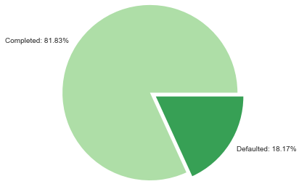
Data exploration
The dataset is unbalanced, with defaulted loans only accounting for 18.17%.
The unbalanced nature of the data will have to be considered when making predictions.

Slide 6
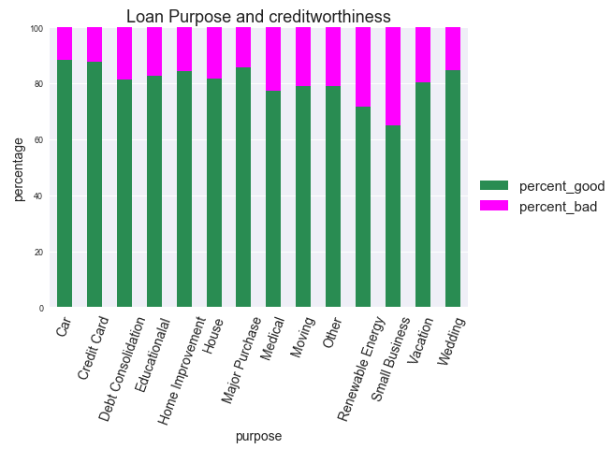
Data exploration
Loan purposes ‘Renewable Energy’ and ‘Small Business’ have the highest percentage of bad loans.

Slide 7
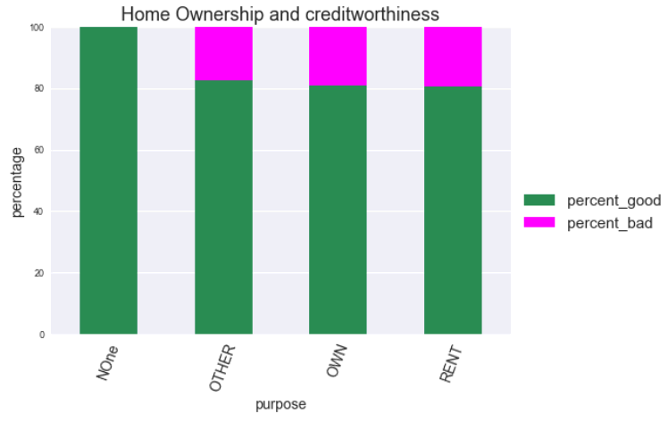
Data exploration
Category ‘None’ only contains completed loans.
Defaults in category ‘Rent’ are marginally higher than in ‘Other and ‘Own’.

Slide 8
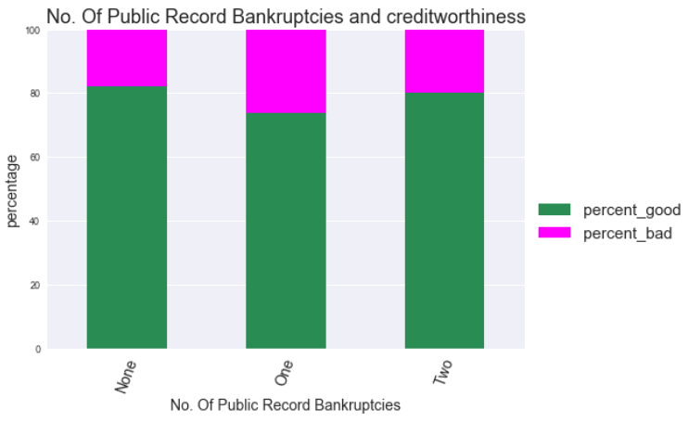
Data exploration
One public record bankruptcy has the highest percentage of bad loans.

Slide 9
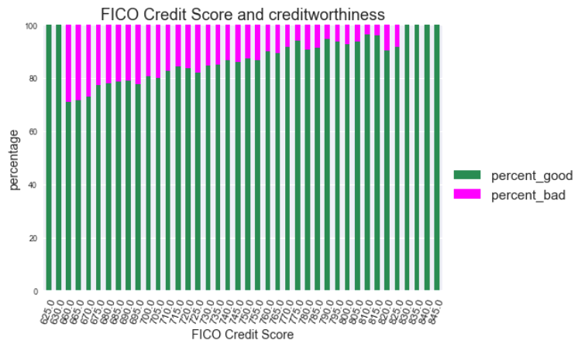
Data exploration
The lowest and the highest FICO scores do not contain bad loans, otherwise bad loans decrease with increase in score.

Slide 10
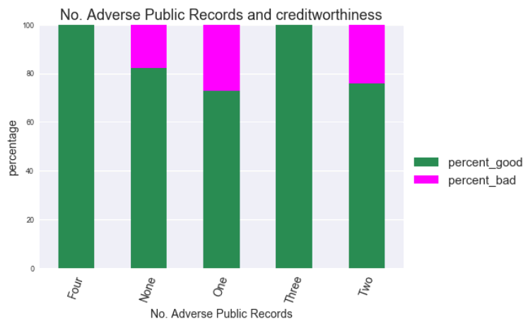
Data exploration
One adverse public record has the highest percentage of bad loans, while three only contain good loans.

Slide 11
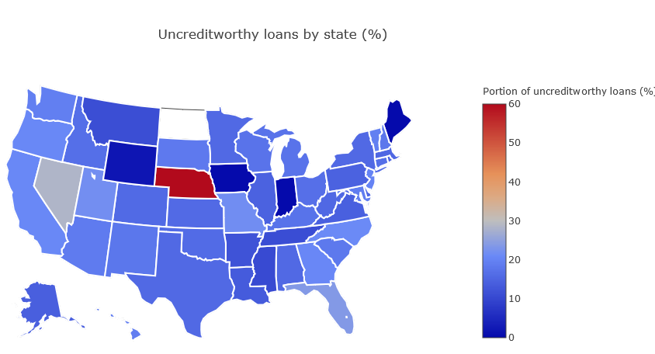
Data exploration
NE stands out as having 60% of bad loans, or 5 bad loans in absolute numbers.
NV has 28.43% of bad loans, or 306 bad loans in absolute numbers.

Slide 12
Data exploration: Initial insights
Relationships between predictor and target variable are not always linear.
Observations of features ‘FICO Credit Score’ and ‘Address State’ can be grouped in order to increase predictive power.

Slide 13
Feature engineering
convert 'Class' feature (=target) into numerical values
Assign ‘0’ to ‘creditworthy’
Assign ‘1’ to ‘uncreditworthy’

Slide 14
Feature engineering
summarise address states into geographic regions:
East_Coast: 7731 observations
South: 6885 observations
West_Coast: 4485 observations
Middle: 3461 observations
North: 2213 observations
summarise FICO scores into categories
Very Good: 15950 observations
Exceptional: 5208 observations
Good: 3337 observations

Slide 15
Feature engineering
create dummy variables for categorical features
'Loan Term',
'Home Ownership',
'Loan Purpose',
'FICO Credit Score',
'Address State'

Slide 16
Feature engineering
encode remaining columns containing object data types
'No. Delinquencies In Last 2 Years‘
'No. Adverse Public Records‘
'No. Of Public Records
The above columns contain strings (e.g. one, two, three, …) describing numbers from 0 to 9
Change strings into numerical format (e.g. 1, 2, 3, …)

Slide 17
Feature engineering
drop redundant feature
Drop ‘Class’ feature
deal with nan values
Replace ‘nan’ with median values for each feature
remove outliers
See appendix

Slide 18
Classification
Define predictor variables (X) and target variable (y)
y = ‘Class_new’ column containing ‘0’ for completed and ‘1’ for defaulted loan
X = transformed features excluding y
Implement train test split on X and y
70% train, 30% test
Stratify target y as data may not be normally distributed

Slide 19
Classification: Evaluation metric
AUC (‘area under the curve’) score
The AUC score equals the probability that a randomly chosen positive example ranks above (is deemed to have a higher probability of being positive than) a randomly chosen negative example.
TPR (also called Recall or Sensitivity) = sum total positives/sum of condition positive = TP/(TP+FN)
FPR (also called Fall-out) = sum of false positives/sum of condition negative = FP/(FP+TN)
The ROC curve is created by plotting the true positive rate (TPR) against the false positive rate (FPR) at various threshold settings.
Source: www.wikipedia.com

Slide 20
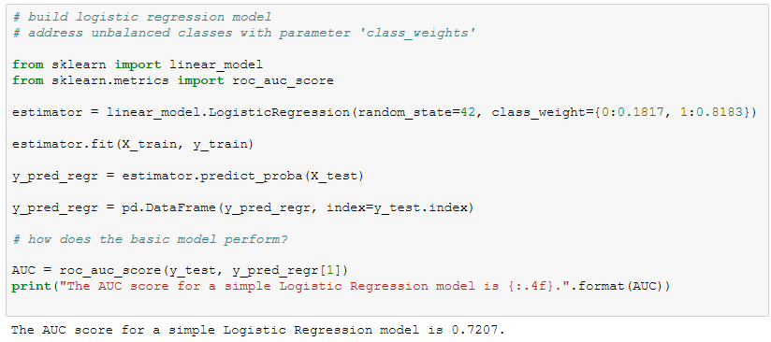
Classification: Build model
Add class weights to account for unbalanced classes
Initial AUC score:
0.7207
Notes:
AUC (‘area under the curve’) score
The AUC score equals the probability that a randomly chosen positive example ranks above (is deemed to have a higher probability of being positive than) a randomly chosen negative example.
TPR (also called Recall or Sensitivity) = sum total positives/sum of condition positive = TP/(TP+FN)
FPR (also called Fall-out) = sum of false positives/sum of condition negative = FP/(FP+TN)
The ROC curve is created by plotting the true positive rate (TPR) against the false positive rate (FPR) at various threshold settings.
Source: www.wikipedia.com

Slide 21
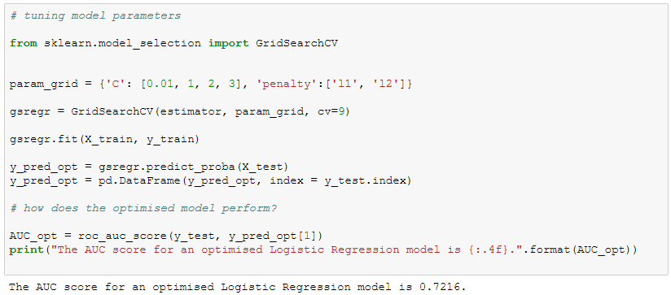
Classification: Optimise model
Use GridSearchCV to find best model parameters
Optimised AUC score: 0.7216

Slide 22
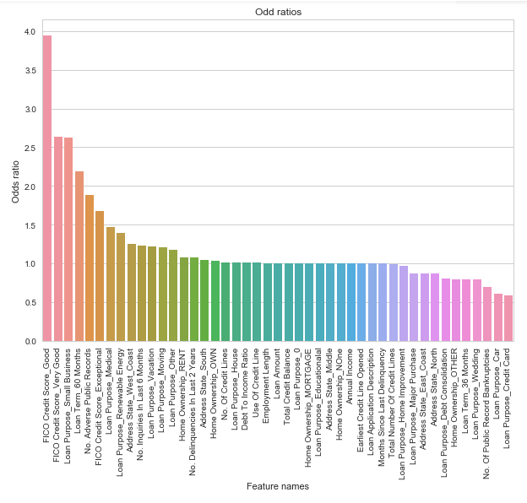
Classification: Feature selection
Highest odds for bad loans:
FICO Credit Score Good
FICO Credit Score Very Good
Loan Purpose Small Business
Loan Term 60 Months
No. Adverse Public Records
Lowest odds for bad loans:
Loan Purpose Credit Card
Loan Purpose Car
No. Of Public Record Bankruptcies
Loan Purpose Wedding
Loan Term 36 Months
Features with odd ratios of 1 have been removed, which increased the AUC score to 0.7223.
Notes:
How to interpret the odds ratio:
A score over 1 indicates a positive relationship with the target variable, a score below 1 a negative one.
Odds of success = ratio of probability of success / probability of failure
If the probability of success is 50/50, the odds of success are 1/1 = 1
For example, FICO Credit Score_Good has an odd ratio of 3.948234. This means than the odds for a defaulted loan are 295% higher than the odds for completed one.
Recursive Feature Elimination
Feature ranking with recursive feature elimination.
Given an external estimator that assigns weights to features (e.g., the coefficients of a linear model), the goal of recursive feature elimination (RFE) is to select features by recursively considering smaller and smaller sets of features. First, the estimator is trained on the initial set of features and the importance of each feature is obtained either through a coef_ attribute or through a feature_importances_ attribute. Then, the least important features are pruned from current set of features. That procedure is recursively repeated on the pruned set until the desired number of features to select is eventually reached.
Eliminated features:
Total Credit Balance
Home Ownership_MORTGAGE
Home Ownership_None
Loan Purpose_0
Loan Purpose_Educationalal
Address State_Middle

Slide 23
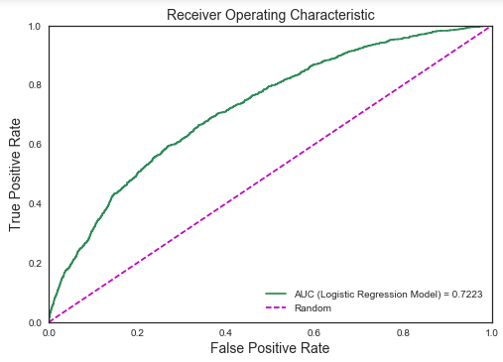
Results: ROC Curve
The optimised model delivered an AUC score of 0.7223.
This can be interpreted as the probability that a randomly chosen positive example is deemed to have a higher probability of being positive than a randomly chosen negative example.
Parameter tuning and feature selection improved the score.
Notes:
A receiver operating characteristic curve or ROC curve is a graph plotting the true positive rate against the false positive rate at different thresholds. It indicates how well a classifier can discriminate positive and negative instances and identify the best threshold for discriminating them. The curve is created by plotting the true positive rate (TPR) against the false positive rate (FPR) at various threshold settings.
TPR (also called Recall or Sensitivity) = sum total positives/sum of condition positive
FPR (also called Fall-out) = sum of false positives/sum of condition negative
The area under the curve (AUC) is equal to the probability that a classifier will rank a randomly chosen positive instance higher than a randomly chosen negative one.

Slide 24
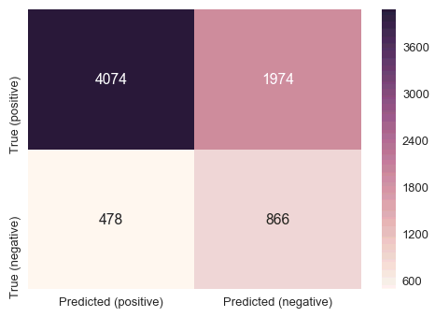
Results: Confusion matrix
Notes:
What is a confusion matrix?
Visualization of the performance of an algorithm
Each row of the matrix represents the instances in a actual class while each column represents the instances in an predicted class

Slide 25
Conclusion
The model outperforms random guessing in predicting loan defaults.
The model identifies features with high and low odds for bad loans.
Limitations
Relationships between predictor variables and target are not necessarily linear.
The amount of features and observations is not very large.
Recommendations
Get more data.
Build model using XG Boost, as this algorithm tends to perform well when variables exhibit non-linear relationships.

Slide 26
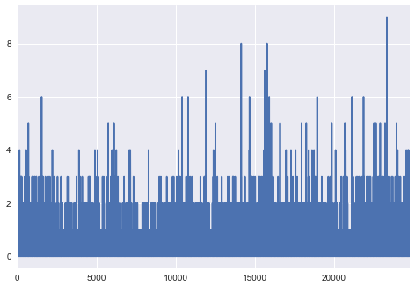
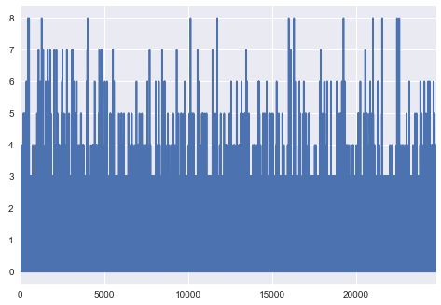
Appendix: Dealing with outliers
No. Delinquencies In Last 2 Years:
Take out values above 4
No. Inquiries In Last 6 Months:
Take out values above 7

Slide 27
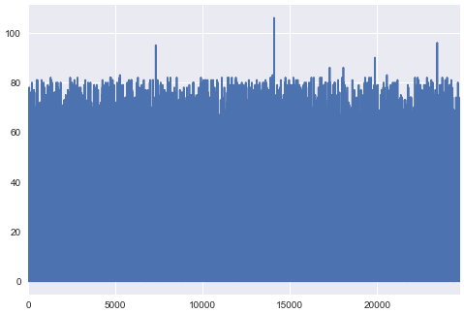
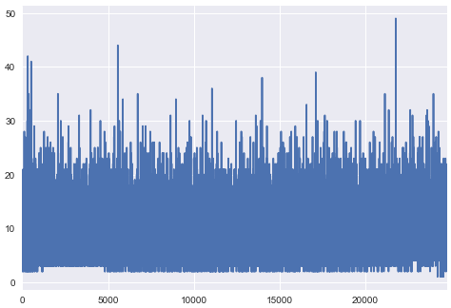
Appendix: Dealing with outliers
Months Since Last Delinquency:
Take out values above 85
No. Of Credit Lines:
Take out values above 30

Slide 28
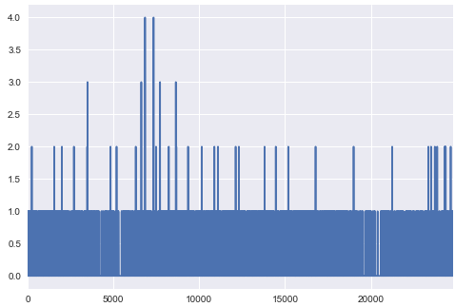
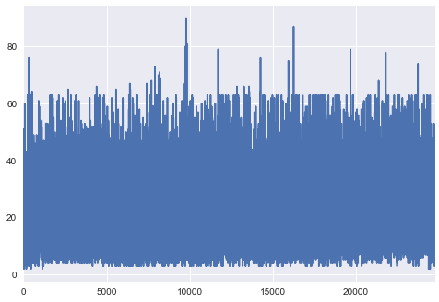
Appendix: Dealing with outliers
No. Adverse Public Records:
Take out values above 1
Total Number Of Credit Lines:
Take out values above 65

Slide 29
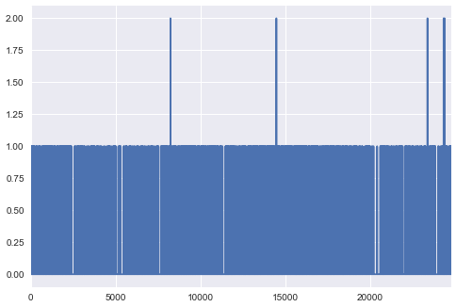
Appendix: Dealing with outliers
No. Of Public Record Bankruptcies:
Take out values above 1

